Slide 1






Global Market
Importer
Importer
Importer
$$\vec{θ}$$
SF Rate
Transition matrix $A$
$$\vec{π}$$
Outlet
Outlet
Outlet
Outlet
Outlet
Outlet
Outlet
Outlet
SF Rate
Key Equations
$$\vec{q}$$
Positive test proportions
$$\hat{θ}={\left(A^{T}A\right)}^{−1}A^{T}\hat{q}$$
$$\hat{π}=\hat{q}−A\hat{θ}$$

Slide 2
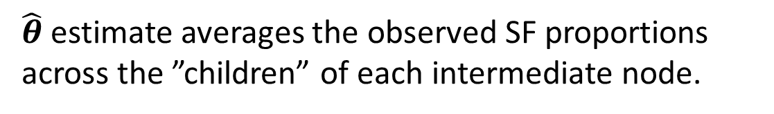
Vertical Supply Chain
Global Market
All outlets procure from a single importer
Importer
Importer
Importer
Outlet
Outlet
Outlet
Outlet
Outlet
Outlet
Outlet
Outlet
$\hat{θ}$ estimate averages the observed SF proportions across the ”children” of each intermediate node.

Slide 3
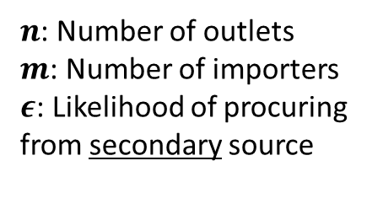
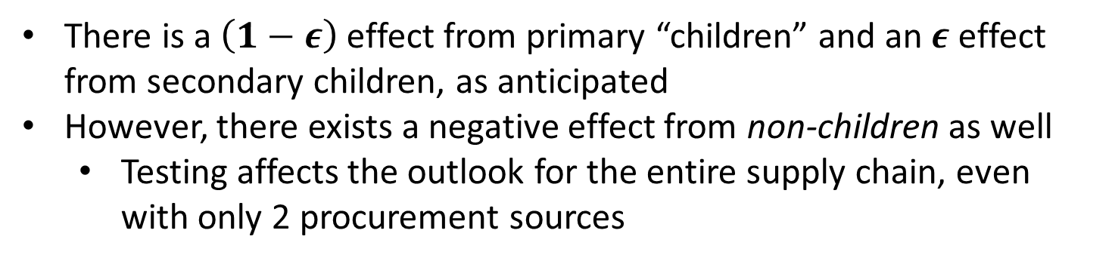
2-Source Balanced Supply Chain
Global Market
All outlets have a primary source and a secondary source
Importer
Importer
Importer
$n$: Number of outlets
$m$: Number of importers
$ε$: Likelihood of procuring from secondary source
Outlet
Outlet
Outlet
Outlet
Outlet
Outlet
Outlet
Outlet
There is a $\left(1−ε\right)$ effect from primary “children” and an $ε$ effect from secondary children, as anticipated
However, there exists a negative effect from non-children as well
Testing affects the outlook for the entire supply chain, even with only 2 procurement sources

Slide 4
Future Research Directions
Describe the contexts under which supply chain analyses merit consideration
How do certain supply chain environments drive selection of one testing diagnostic tool (e.g., PADs) over another? Sensitivity/specificity impacts
Integrate supply-chain information gain into sampling strategies
Evaluate market share effects
Develop statistics to flag problem sources
Investigate multi-tier systems (more than 2 echelons)
Tie to procurement from international sources (outside national regulation) – what are the implications for coordination among procuring countries?
Should procurement/inventory policies be an element of pharmacological regulation, so that problem sources can be more quickly identified? What is the benefit?

